Slide 1


發票數字辨識
S0961001 陳常葳

Slide 2
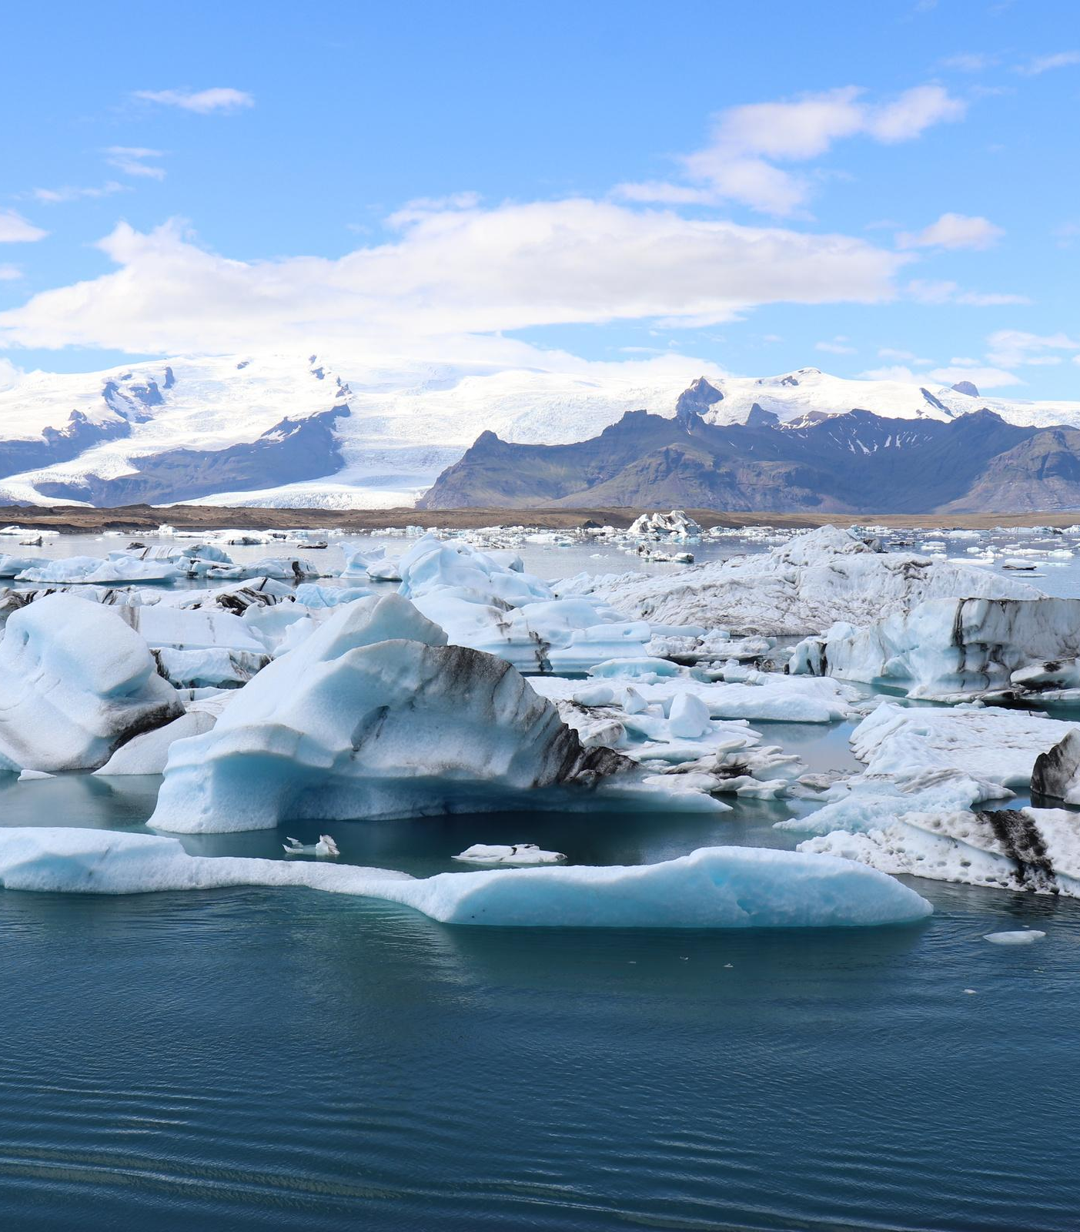


CONTENT
主題動機
執行策略
解決方法
結果
心得

Slide 3


主題動機

Slide 4


主題動機
APP程式設計課程需要
想要做載具，可是沒有發票辨識API
課程教學內容
上學期修過機器學習，今年想做不一樣的 => 非監督式學習

Slide 5

執行策略

Slide 6


建模方向
辨識數字不用很高的解釋型，只要模型越準確越好
建立多個不同的模型，選擇準確度最高的作為最後的模型

Slide 7

以MINST建立辨識模型
蒐集data
處理data
套入模型
先將數字辨識的模型建立，供日後辨識發票號碼使用
先將手邊發票全部拍攝，做為資料集
用python處理拍攝的資料，鎖定要掃描的位置，並將圖片轉為灰階色彩模式
以處裡過後的圖片資料作為辨識模型所使用的資料，用CNN和神經網路的方法建立模型

Slide 8
載入MNIST 資料集
1.把MNIST資料抓出來，分成traing&test，其中也分開圖片及數字標籤
(x_train, y_train), (x_test, y_test) = mnist.load_data()
##手寫數字的MNIST有60000個training data及10,000個testing data。
#數字已正規化且在固定大小的影像置中
2.看一下原本資料集圖片
plt.figure(figsize=(15,15)) #設定圖片呈現大小
for i in range(0,20):
ax=plt.subplot(2,10,1+i)
ax.imshow(x_train[i]) #加入cmap='gray'可以看黑白圖片
title= str(y_train[i])
ax.set_title(title, fontsize=18)
plt.tight_layout()
plt.show()

Slide 9
載入MNIST 資料集
3. 圖片色彩轉換&更改維度
##將圖片轉成二維的資料
x_train= x_train.reshape(60000, 28*28).astype('float32')
x_test = x_test.reshape(10000, 28*28).astype('float32')
print("training image =", x_train.shape)
print("testing image =",x_test.shape)
##原圖是彩色的--->把圖片變黑白
x_train = x_train/255
x_test = x_test/255
4. 把數字標籤做成dummy variable
from keras.utils import np_utils # 用來後續將 label 標籤轉為 one-hot-encoding
# 將 training 的 label 進行 one-hot encoding (dummyvariable)
y_train_dummy = np_utils.to_categorical(y_train)
y_test_dummy = np_utils.to_categorical(y_test)

Slide 10
模型建立：Neural Network
# 建立簡單的線性執行的模型
model_neural = Sequential()
# Add Input layer
model_neural.add(Dense(units=512, input_dim=784, kernel_initializer='normal', activation='relu'))
# 中間的hidden layer
model_neural.add(Dense(units=512, input_dim=512, kernel_initializer='normal', activation='relu'))
model_neural.add(Dense(units=256, input_dim=512, kernel_initializer='normal', activation='relu'))
# Add output layer
model_neural.add(Dense(units=10, kernel_initializer='normal', activation='softmax’))
model_neural.compile(loss='categorical_crossentropy', optimizer='adam', metrics=['accuracy'])
# 進行訓練, 訓練過程會存在 train_history 變數中
train_history = model_neural.fit(x=x_train, y=y_train_dummy, validation_split=0.2, epochs=10, batch_size=800, verbose=2)
# 顯示訓練成果(分數)
scores = model_neural.evaluate(x_test, y_test_dummy)
print()
print("\t[Info] Accuracy of testing data = {:2.1f}%".format(scores[1]*100.0))
# 預測
X = x_test[:,:]
predictions = np.argmax(model_neural.predict(X), axis=-1)
# get prediction result
print(predictions)

Slide 11
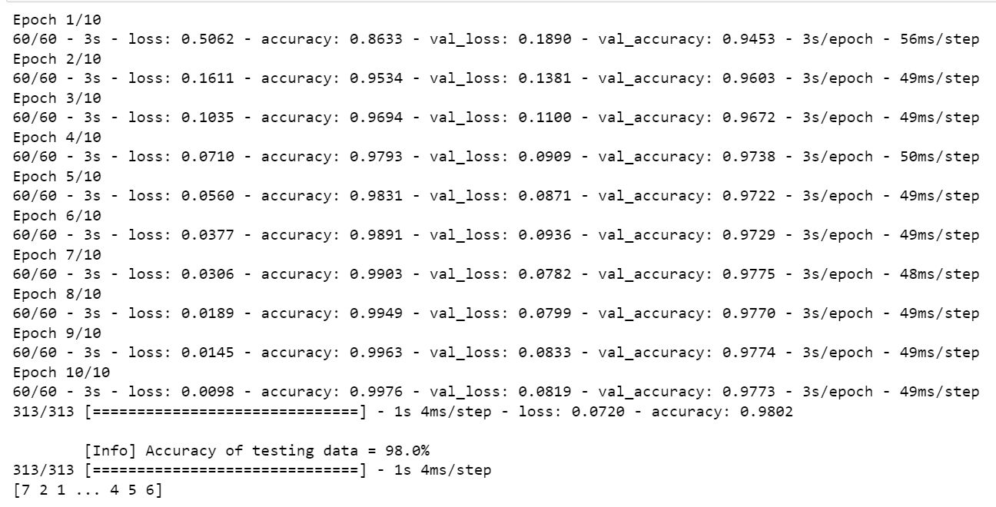
Neural Network

Slide 12
模型建立：CNN Lenet-5
# 建立簡單的線性執行的模型
model_neural = Sequential()
# Add Input layer
model_neural.add(Dense(units=512, input_dim=784, kernel_initializer='normal', activation='relu'))
# 中間的hidden layer
model_neural.add(Dense(units=512, input_dim=512, kernel_initializer='normal', activation='relu'))
model_neural.add(Dense(units=256, input_dim=512, kernel_initializer='normal', activation='relu'))
# Add output layer
model_neural.add(Dense(units=10, kernel_initializer='normal', activation='softmax’))
model_neural.compile(loss='categorical_crossentropy', optimizer='adam', metrics=['accuracy'])
# 進行訓練, 訓練過程會存在 train_history 變數中
train_history = model_neural.fit(x=x_train, y=y_train_dummy, validation_split=0.2, epochs=10, batch_size=800, verbose=2)
# 顯示訓練成果(分數)
scores = model_neural.evaluate(x_test, y_test_dummy)
print()
print("\t[Info] Accuracy of testing data = {:2.1f}%".format(scores[1]*100.0))
# 預測
X = x_test[:,:]
predictions = np.argmax(model_neural.predict(X), axis=-1)
# get prediction result
print(predictions)

Slide 13
Neural Network

Slide 14

真實資料編輯

Slide 15
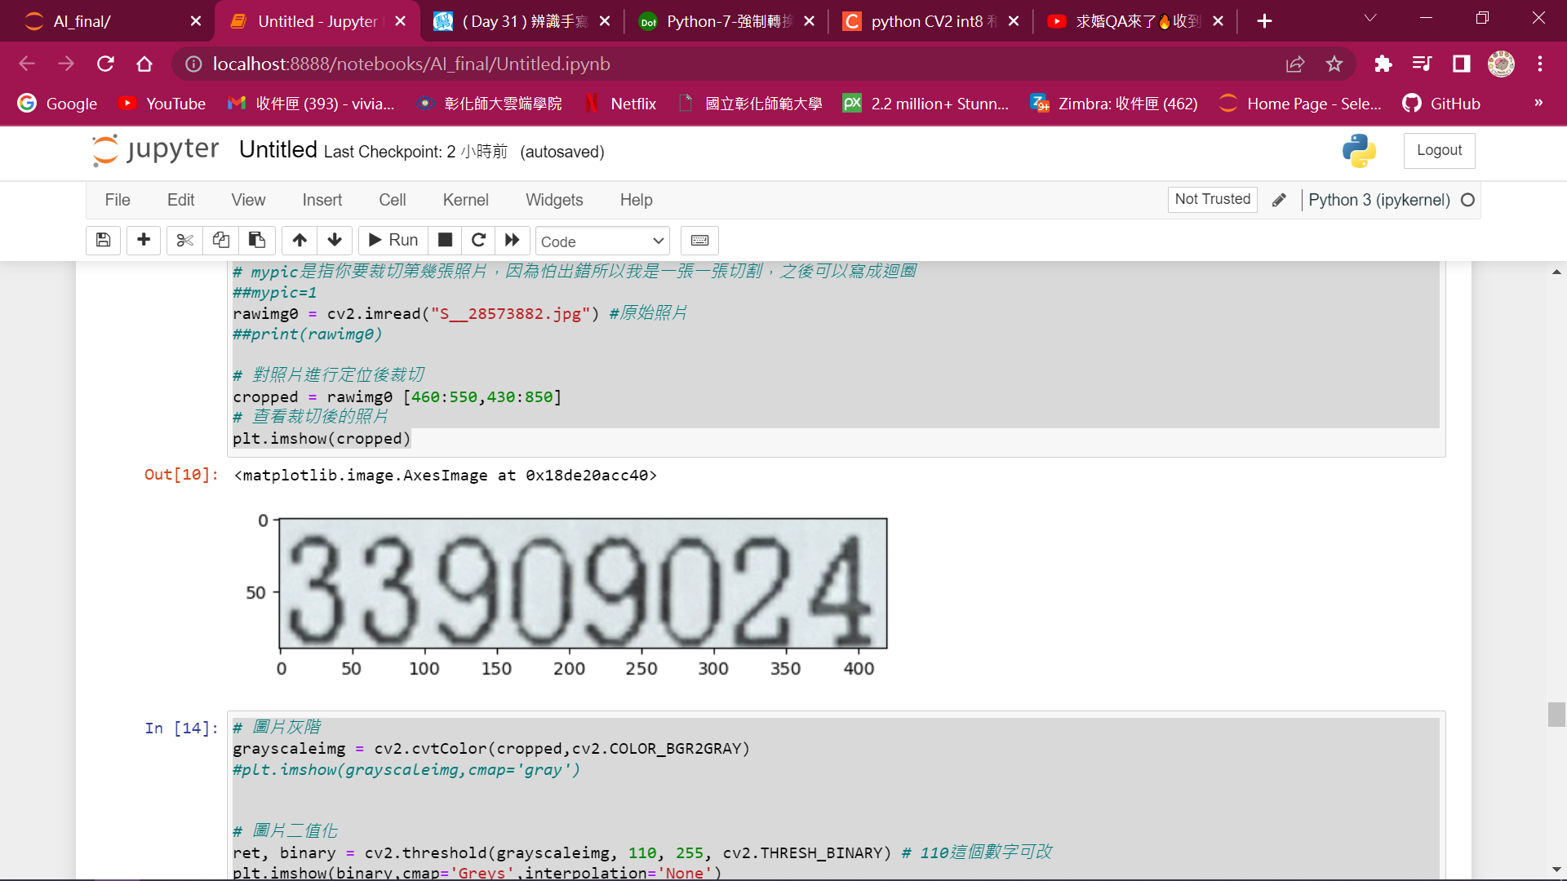
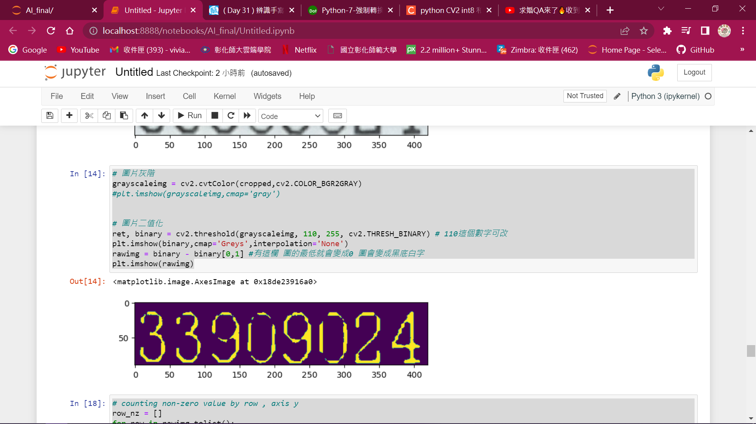
os.chdir('D:\invoice')
# mypic是指你要裁切第幾張照片，因為怕出錯所以我是一張一張切割，之後可以寫成迴圈
##mypic=1
rawimg0 = cv2.imread("S__28573882.jpg") #原始照片
##print(rawimg0)
# 對照片進行定位後裁切
cropped = rawimg0 [460:550,430:850]
# 查看裁切後的照片
plt.imshow(cropped)
# 圖片灰階
grayscaleimg = cv2.cvtColor(cropped,cv2.COLOR_BGR2GRAY)
#plt.imshow(grayscaleimg,cmap='gray')
# 圖片二值化
ret, binary = cv2.threshold(grayscaleimg, 110, 255, cv2.THRESH_BINARY) # 110這個數字可改
plt.imshow(binary,cmap='Greys',interpolation='None')
rawimg = binary - binary[0,1] #有這欄 圖的最低就會變成0 圖會變成黑底白字
plt.imshow(rawimg)

Slide 16
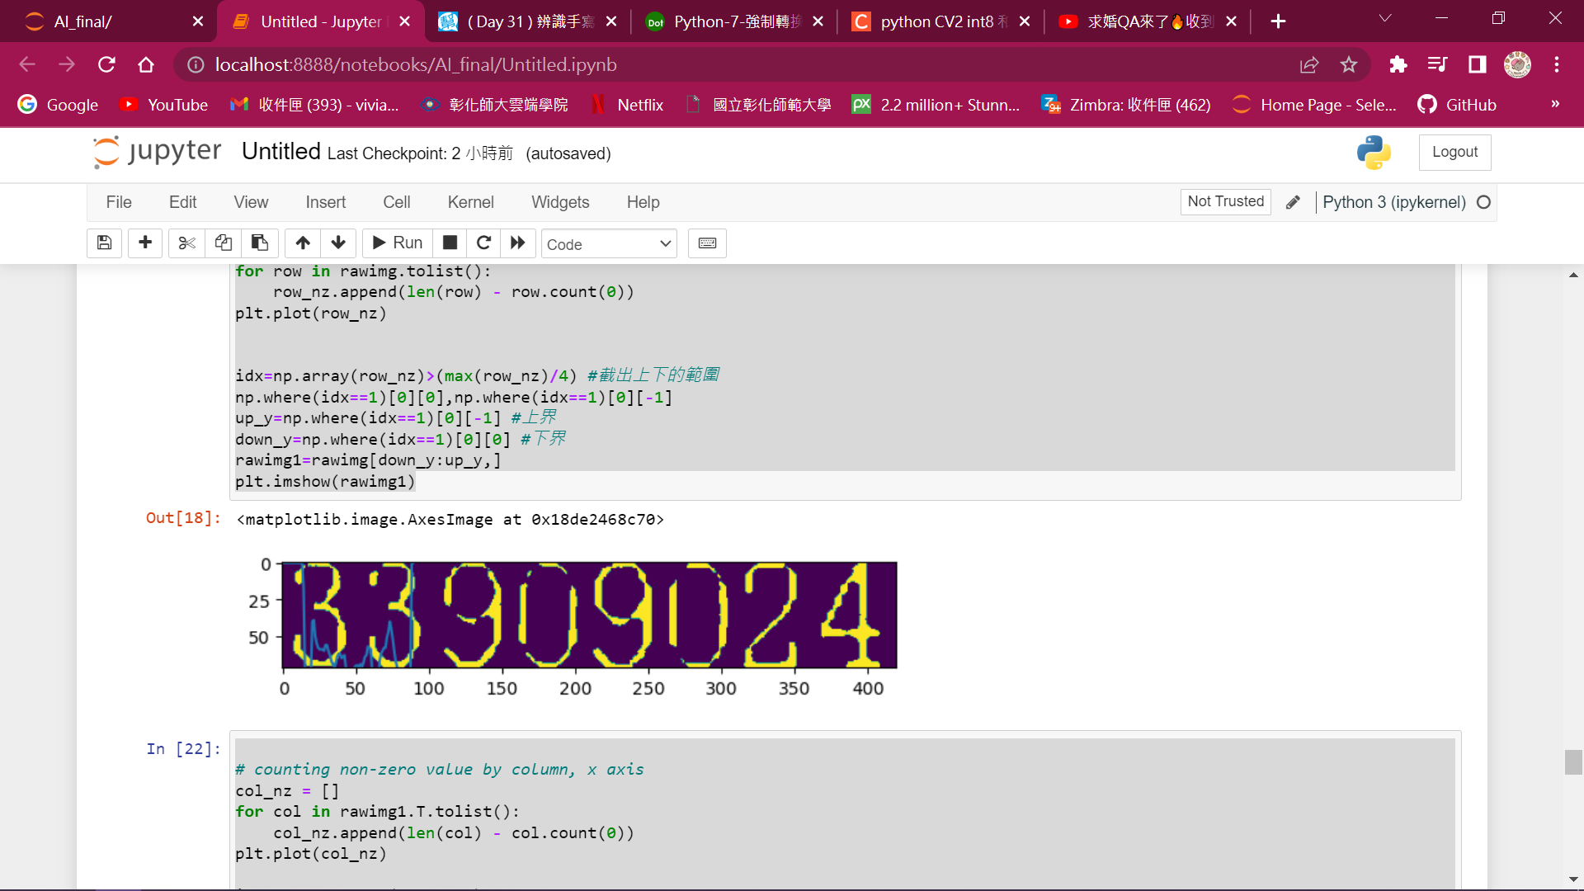
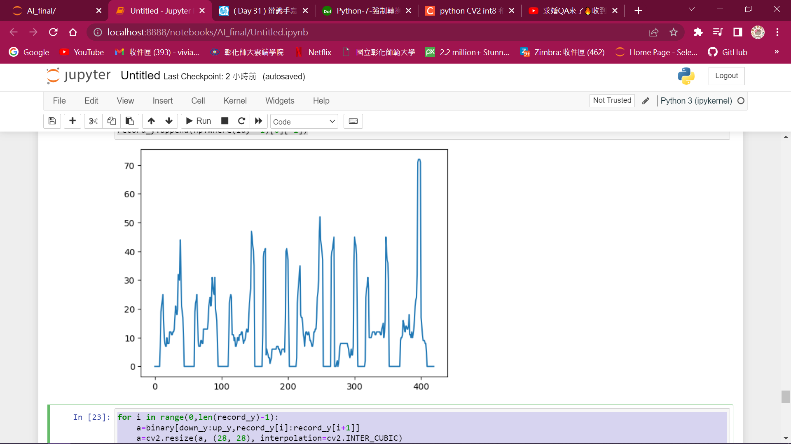
# counting non-zero value by row , axis y
row_nz = []
for row in rawimg.tolist():
row_nz.append(len(row) - row.count(0))
plt.plot(row_nz)
idx=np.array(row_nz)>(max(row_nz)/4) #截出上下的範圍
np.where(idx==1)[0][0],np.where(idx==1)[0][-1]
up_y=np.where(idx==1)[0][-1] #上界
down_y=np.where(idx==1)[0][0] #下界
rawimg1=rawimg[down_y:up_y,]
plt.imshow(rawimg1)

Slide 17
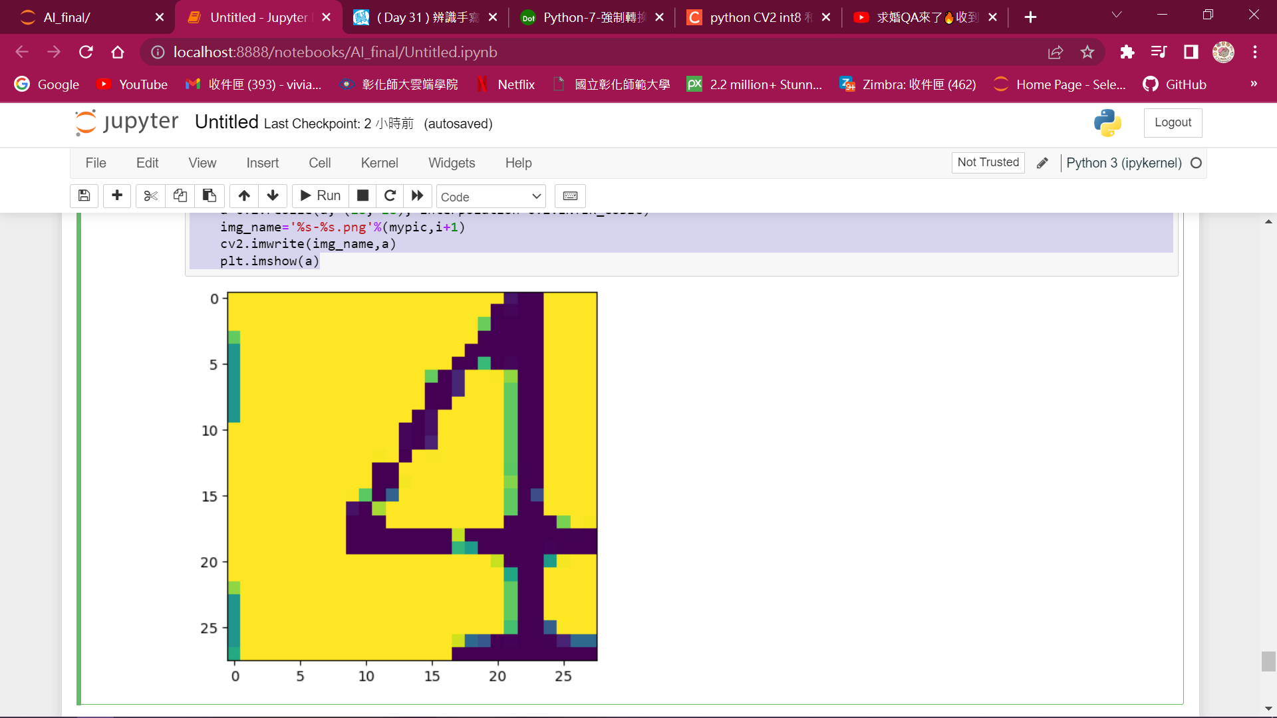
# counting non-zero value by column, x axis
col_nz = []
for col in rawimg1.T.tolist():
col_nz.append(len(col) - col.count(0))
plt.plot(col_nz)
idy=np.not_equal(col_nz,0)
record_y=[] #如果有八個數字，裡面應該要有九個格子(一開始找出七個，前後插入變九個)
for i in range(0,(len(np.where(idy==1)[0])-1)):
# 如果下一個數是0就略過，直到找到下一個數不是0的位置
if(np.where(idy==1)[0][i+1]-np.where(idy==1)[0][i]==1):
pass
else:
record_y.append(np.where(idy==1)[0][i])
# 插入第一個非0位置跟最後一個非0的位置
record_y.insert(0,np.where(idy==1)[0][0])
record_y.append(np.where(idy==1)[0][-1])
for i in range(0,len(record_y)-1):
a=binary[down_y:up_y,record_y[i]:record_y[i+1]]
a=cv2.resize(a, (28, 28), interpolation=cv2.INTER_CUBIC)
img_name='%s-%s.png'%(mypic,i+1)
cv2.imwrite(img_name,a)
plt.imshow(a)

Slide 18
真實資料套入

Slide 19
結果

Slide 20

心得感想

Slide 21


心得
寫python上的困難
統計學背景
沒有組員

Slide 22


Thank
you

Slide 23

Add a Team Members Page
Elaborate on what you want to discuss.
Name
Name
Name
Name
Title or Position
Title or Position
Title or Position
Title or Position

Slide 24
S
W
O
T
STRENGTHS
WEAKNESSES
OPPORTUNITIES
THREATS
What are you doing well?
What sets you apart?
What are your good qualities?
Where do you need to improve?
Are resources adequate?
What do others do
better than you?
What are your goals?
Are demands shifting?
How can it be improved?
What are the blockers
you're facing?
What are factors outside
of your control?

Slide 25



Write Your Topic or Idea
Add a main point | Elaborate on what you want to discuss.
Add a main point | Elaborate on what you want to discuss.
Add a main point | Elaborate on what you want to discuss.
Add a main point | Elaborate on what you want to discuss.
Add a main point | Elaborate on what you want to discuss.

Slide 26



WRITE YOUR TOPIC OR IDEA
ADD A MAIN POINT
ADD A MAIN POINT
ADD A MAIN POINT
Briefly elaborate on
what you want to discuss.
Briefly elaborate on
what you want to discuss.
Briefly elaborate on
what you want to discuss.

Slide 27


Write Your Topic or Idea
1ST QUARTER | 2ND QUARTER | 3RD QUARTER | 4TH QUARTER
January | April | July | October
Double click to add task | Double click to add task | Double click to add task | Double click to add task
February | May | August | November
Double click to add task | Double click to add task | Double click to add task | Double click to add task
March | June | September | December
Double click to add task | Double click to add task | Double click to add task | Double click to add task

